Slide 1
MODEL-BASED DEVELOPMENT METHODOLOGY
BY LAVANYA GADDAM

Slide 2

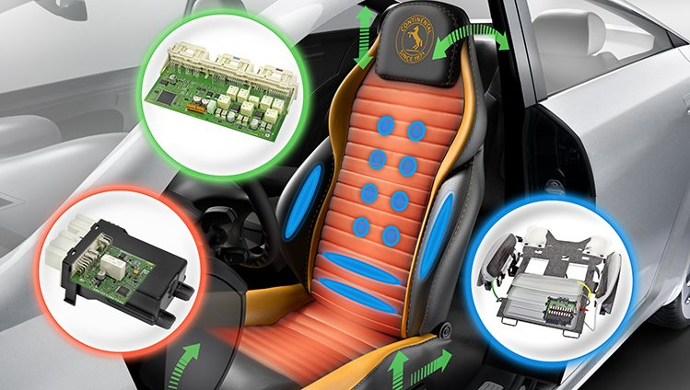
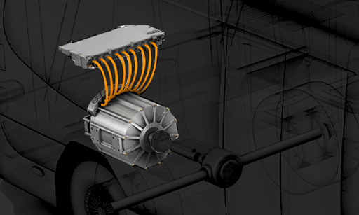
MBD is a software development methodology based on v-cycle.
A mathematical and visual approach to solving issues related to the design of intricate controls, signal processing, and communication systems is known as "model-based development."
Motion control, industrial machinery, aerospace, and automotive applications all make use of MBD.

Slide 3
Architecture needs
Use case
Building block
Break down of high case models
Validate
Use abstract items to create verification process activities
Abstract items
Wide range of inbuilt operators, elements, components and user addable
High level case models
What are all subsystems involved
such as software component, a
target system
sequence actions to be conducted inside function
Models or model generated code can be taken to testing

Slide 4
Two types of models:
Plant Model – Input and Output
Controller Model – Controller
Input
Controller
Output
Model based Dev tools
UML/ Tools specific diagrams
Auto code generation
Configuration

Slide 5
Actual process in MBD
Model-in-the -loop (MIL)
Software-in-the -loop (SIL)
Processor-in-the -loop (PIL)
Hardware-in-the -loop (HIL)
Model-in-the -loop (MIL):
Without any actual hardware, models are simulated in the simulated environment.
Enables for early stage testing.

Slide 6
Software-in-the -loop (SIL):
Generation of code for the controller model and replacement of this code in the controller block.
Executable code is tested with a modelling environment.
Helps to verify the software.
Processor-in-the -loop (PIL):
Software is evaluated to see if it will work in the intended setting i.e in the embedded environment.
software conformity with business requirements is assessed.

Slide 7
Hardware-in-the -loop (HIL):
Embedded software is tested with actual hardware.
Gives realistic Feedback
Benefits of MBD:
Higher productivity
Best suited for Agile
Auto code generation
Higher software efficiency
Architecture consistency can be checked at all levels

Slide 8
Limitations of MBD
High cost and complex code generation
Code generators must be qualified for respective domain standards
Handwritten code requires manual qualification

